Slide 1
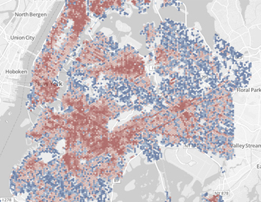
Final Assignment Proposal
YUE ZHAO
Global Terrorism Database
Data Source:
National Consortium for the Study of Terrorism and Responses to Terrorism (START). (2017).
Questions:
Which country is the worst terrorist attack?
Where is the area most affected by the terrorist attacks?
What is the maximum number of victims killed in the attack?
What are the most prominent types of Attack？
What is the relationship between the attack rate and the national population?
Python Modules To Use:
Pandas
Numpy
Matplotlib
Basemap
Seaborn
Visualization type:
map

